Slide 1
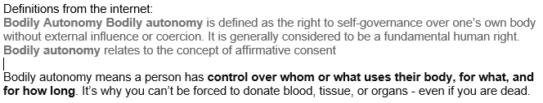
Starter
Vocabulary Check
Body Autonomy
In short, you (and only you) decide what happens to you body and when. This refers more to permanent changes to your body e.g. parents can decide that it’s time for a bath/shower or a haircut.

Slide 2
LO: Taking care of their body, understanding that they have the right to protect their body from inappropriate and unwanted contact
Identify ways of taking care of their body
2) Understand that everyone in the UK has the right to body autonomy
3) Identify ways of managing unwanted or inappropriate contact

Slide 3


How can we take care of our bodies?
Mental health is very important but we’re focusing more on physical health in this lesson
Share your ideas
Hopefully you get everything that we discussed during our first PSHE lesson this year!

Slide 4

Good diet
This gives the body all of the vitamins, minerals and nutrients that it needs to keep organs functioning well and bodily tissue healthy

Slide 5

Exercise
This is closely linked to longer life and reduced risk of serious illness or disease in later life.

Slide 6

Good Hygiene
This reduces the risk of viruses, bacteria or pathogens (that are detrimental to health) from entering the body.

Slide 7

Getting enough sleep
This allows your body to repair itself and continue to function well and fight off illness and disease.

Slide 8

Visiting the doctors and dentists
This allows any illness or any problems with your health to be identified and resolved.

Slide 9
Do you think there is anything that we’ve missed?
Did we think about, or did anyone record, how to prevent harm coming to your body from other people?

Slide 10
Body Autonomy
Everyone, within the UK, has the right to body autonomy. Nobody (including parents) can alter or change your body without your permission (within reason) or until you are 18. This is the reason why things like tattoos are illegal in the UK until you are 18.
Body autonomy includes physical contact.

Slide 11
Vocabulary check
Unwanted contact
Physical contact that is not wanted or liked. You have the right to inform people politely about unwanted contact and then report the issue if it doesn’t stop.
Inappropriate contact
Physical contact that is not acceptable, given the circumstances

Slide 12
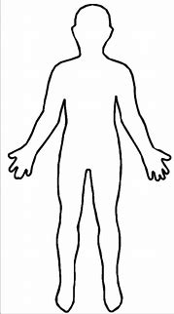
Inappropriate contact
Maturity!
Where is it unacceptable for others to make contact with you or for you to make contact with others?
A few exceptions do exist e.g. a doctor might need to see or touch a certain part of your body.

Slide 13
What can we do if somebody makes unwanted or inappropriate physical contact?
Severity and response
e.g. a touch on the shoulder from a friend or someone that you work with probably doesn’t need to be reported straight away. Just let them know that you don’t like it if it’s the first time and report it if it continues.
e.g. somebody touching a private part of your body or trying to permanently change your body is much more serious and this should be reported to somebody straight away without delay.

Slide 14
Some examples of inappropriate contact
Private parts/areas of the body
Repeated contact on non-private parts of the body if you have asked for it to stop – everyone is different and some people just don’t like to be touched full stop
Hitting or physical abuse (including parents)
Contact from complete strangers for no reason

Slide 15
Plenary
Discuss with your partners…
Think of something that you would classify as unwanted or inappropriate physical contact and discuss how you would manage and deal with it.

