Slide 1
Starter
Ground Rules
Maturity is expected today – it’s a serious issue that is being discussed

Slide 2
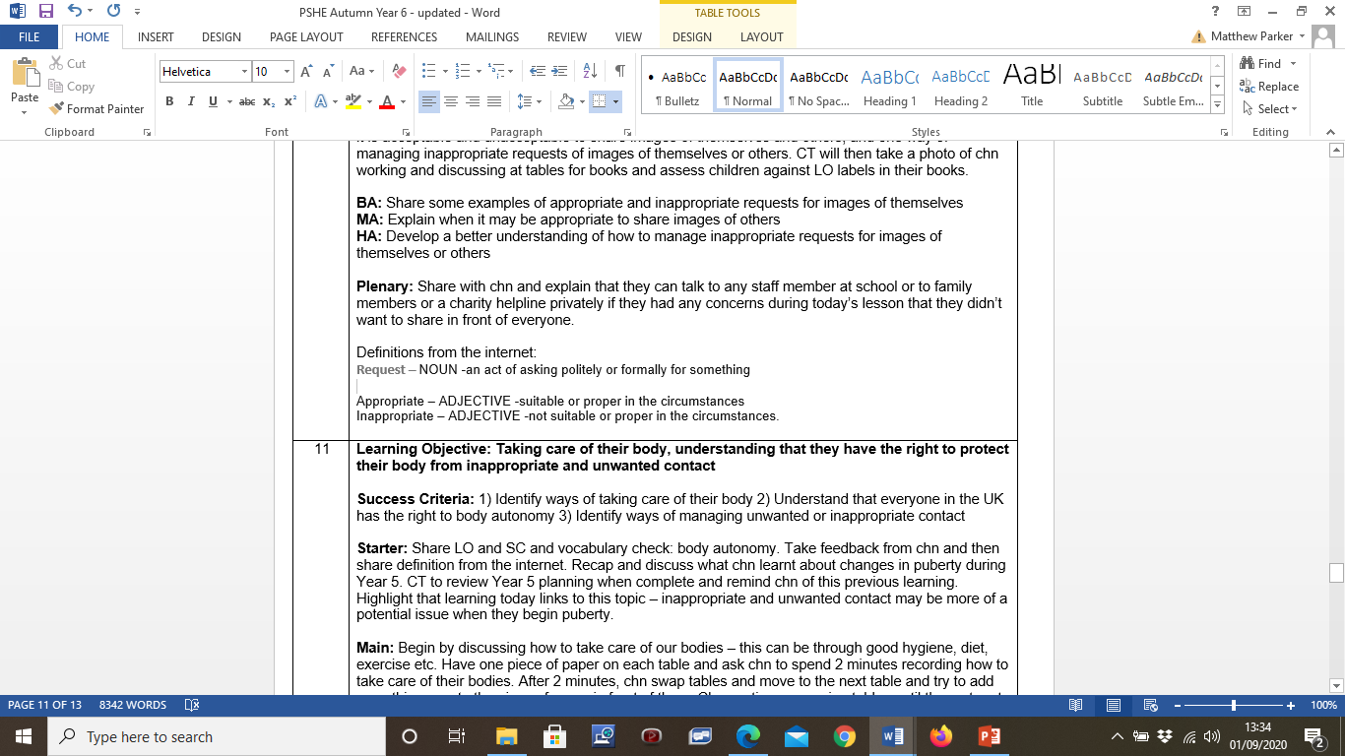

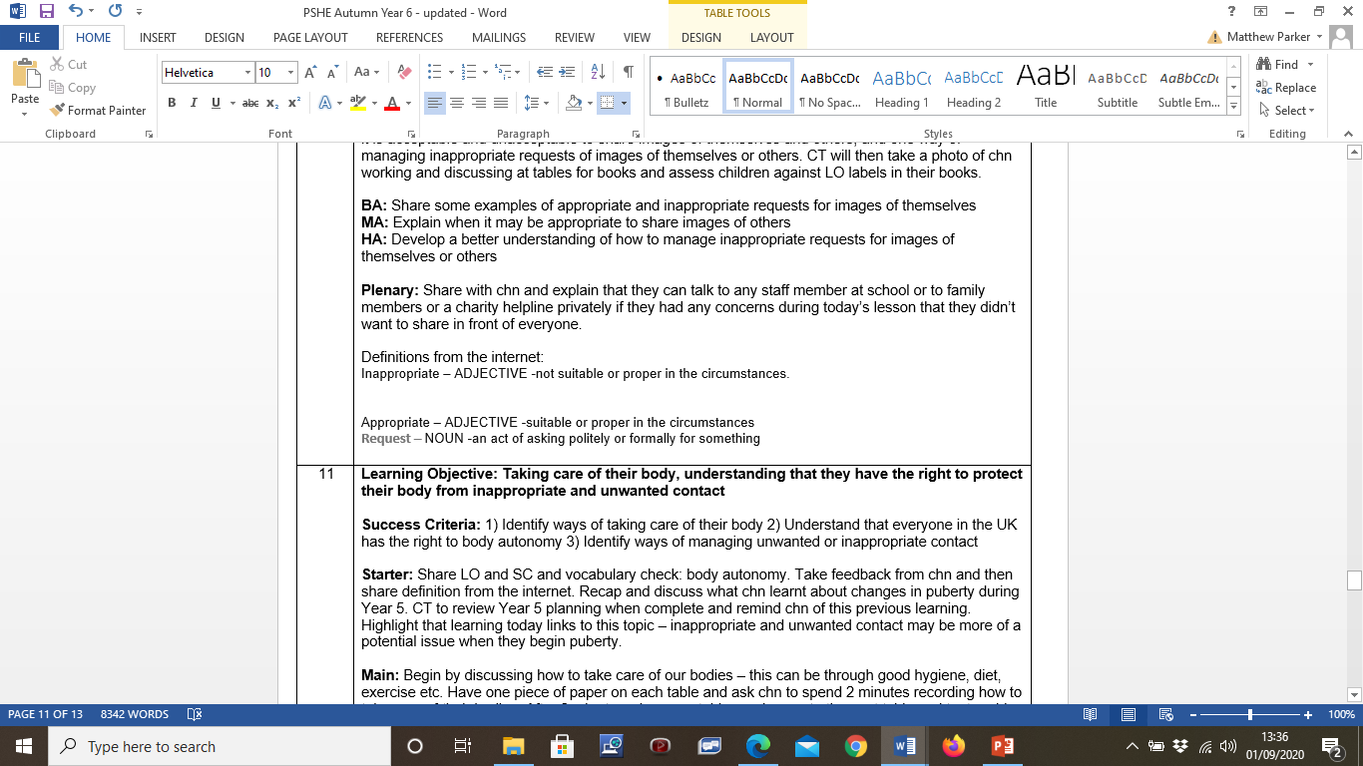
Starter
Vocabulary check
Request:
Appropriate:
Inappropriate:

Slide 3
Starter
Vocabulary check
Appropriate request:
Asking for something that is acceptable, given the circumstance.
Inappropriate request:
Asking for something that is unacceptable, given the circumstance.

Slide 4
LO: How to manage requests for images of themselves or others; what is and is not appropriate to ask for or share; who to talk to if they feel uncomfortable or are concerned by such a request
Understand when it is acceptable or unacceptable to send an image of themselves or others
2) Explain what is appropriate and not appropriate to ask for or share
3) Identify ways of managing inappropriate requests

Slide 5
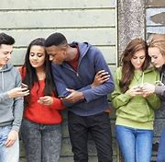




We will be discussing requests for images of yourselves or others today

Slide 6
Should you ever share images of yourselves or others?
Yourself
Others
Yes – given that the circumstances are appropriate
Never without their permission

Slide 7



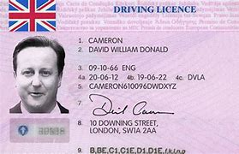
When is it appropriate and inappropriate to send an image of yourself to someone?

Slide 8
Some examples … a short list and not all
Inappropriate requests
Sharing images of others without their permission
When it’s someone you don’t know/strangers
When somebody has asked for lots of images or a really specific request – this could be identity theft. Think – if it sounds weird and not quite right, then this is probably the case.
Nude or naked images of yourself or others. This is illegal and will result in police and criminal action being taken (both sender and receiver) - especially if those involved are under a certain age.

Slide 9
Some examples … a short list and not all
Appropriate requests
Every situation is different but if it is someone that you trust and they are asking for a photo of a non-private area for a certain reason e.g. they might want to add your photo to a scrapbook as a memory for someone who is leaving
Formal reasons e.g. applications for driving licence, passport, national insurance card etc. Always make sure that the site is verified, secure and official!
When applying for a job on your CV
Sensible images on social media – check your privacy settings!

Slide 10
How can we manage inappropriate requests for images?

Slide 11


If you want or need to talk to someone, who is their to talk to?
Parents or family members
Teachers or school staff
Charity helplines
Other trusted adults e.g. police

Slide 12
Task
Write some examples of appropriate and inappropriate requests for images of themselves
Explain when it may be appropriate to share images of others
What would you do to manage inappropriate requests for images of themselves or others?

Slide 13
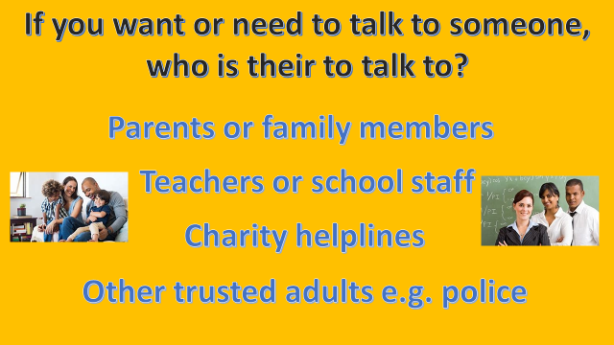
Plenary
If you had any concerns during today’s lesson or if you think that inappropriate requests have already been made for images of yourself or someone that you know, you can speak to any of these people in private after today’s lesson.

