Slide 1


Starter
How can we take care of our bodies?
Mental health is very important but we’re focusing more on physical health in this lesson
Share your ideas
Hopefully you get everything that we discussed during our first PSHE lesson this year!

Slide 2
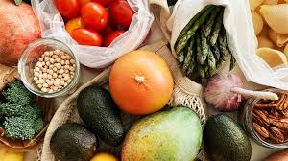
Starter
Good diet
This gives the body all of the vitamins, minerals and nutrients that it needs to keep organs functioning well and bodily tissue healthy

Slide 3

Starter
Exercise
This is closely linked to longer life and reduced risk of serious illness or disease in later life.

Slide 4

Starter
Good Hygiene
This reduces the risk of viruses, bacteria or pathogens (that are detrimental to health) from entering the body.

Slide 5
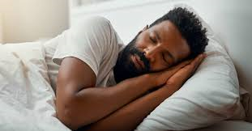
Starter
Getting enough sleep
This allows your body to repair itself and continue to function well and fight off illness and disease.

Slide 6

Starter
Visiting the doctors and dentists
This allows any illness or any problems with your health to be identified and resolved.

Slide 7
Starter
Do you think there is anything that we’ve missed?
Did we think about, or did anyone record, how to prevent harm coming to your body from other people?

Slide 8
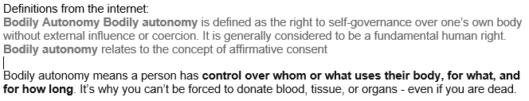
Starter
Vocabulary Check
Body Autonomy
In short, you (and only you) decide what happens to you body and when. This refers more to permanent changes to your body e.g. parents can decide that it’s time for a bath/shower or a haircut.

Slide 9
LO: Taking care of their body, understanding that actions such as FGM constitute abuse and are a crime and develop the skills and strategies required to get support if they have fears for themselves or their peers
Identify ways of taking care of their body
2) Understand that everyone has the right to body autonomy in the UK and that certain actions constitute abuse and are a crime
3) Identify strategies or ways of getting support if they have fears for themselves or their peers

Slide 10
Body Autonomy
Everyone, within the UK, has the right to body autonomy. Nobody (including parents) can alter or change your body without your permission (within reason) or until you are 18. This is the reason why things like tattoos are illegal in the UK until you are 18.
Body autonomy includes physical contact.

Slide 11
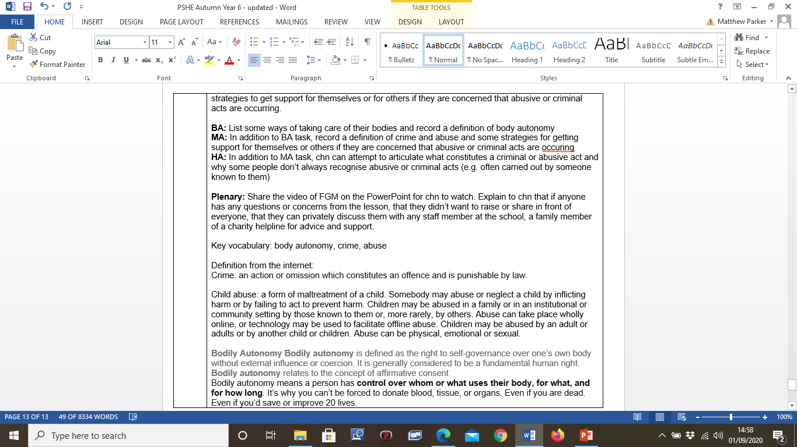
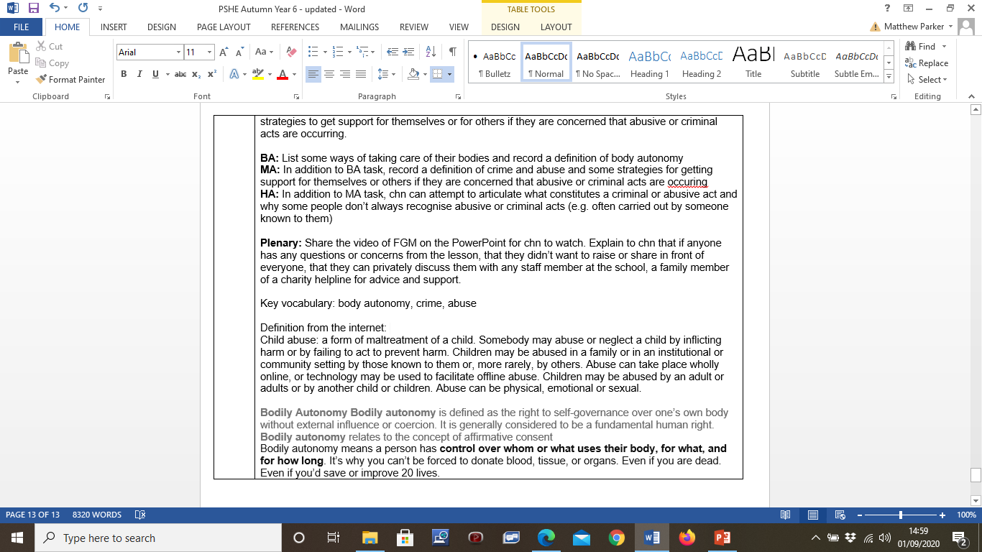
Vocabulary Check
Crime
Child abuse

Slide 12
Crime
Within the UK, permanent changes (within reason*) to bodies before the age of 18 are seen as acts that go against the basic human right of body autonomy. These acts are a crime within the UK and are punishable by law.
* e.g. parents making you get a sensible haircut isn’t seen as a crime

Slide 13
Child abuse
Most acts that constitute abuse and that are punishable by law are carried out by family members or those known by the victim. It’s important that you understand what it classified as abuse, what is illegal and what is a crime.

Slide 14
Child abuse
Permanent changes to your body before the age of 18 is a crime
Causing harm (physical, emotional or sexual) to children or preventing this harm from happening is a crime

Slide 15
Child abuse
We can’t discuss every scenario but what can we do if we are concerned for ourselves or others and if we think that some form of abuse or crime has taken place or will take place?
Never keep it to yourself. Talk to somebody – anybody! If it turns out to be nothing, it’s still better to share it if you’re concerned.

Slide 16
Plenary
https://www.bing.com/videos/search?q=my+body+my+rules+youtube&view=detail&mid=3AF478CA92AB8FBC65E43AF478CA92AB8FBC65E4&FORM=VIRE
If anybody has any concerns from todays lesson and they are worried that abuse or a crime may have already happened or will happen to themselves or others, please speak to an adult as soon as you can after this lesson. Which adults can you talk to?

